Slide 1

Adolescent Safety Scanning Day Briefing
Today, we will use magnetic resonance imaging (MRI) to understand how your brain responds when completing tasks.
Reminder: You can stop participating at any point if you feel uncomfortable. Feel free to refer to the plain language statement or to ask any questions during this briefing.
Ethics Number: 2023-27613-44212-3

Slide 2
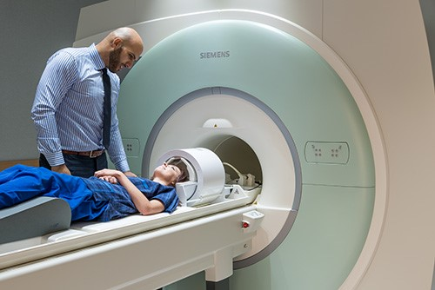
Scanning
The MRI for this study should take approximately 60 minutes, there will be some scans where you will play some games.
Ethics Number: 2023-27613-44212-3

Slide 3
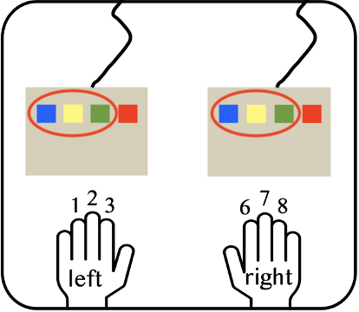
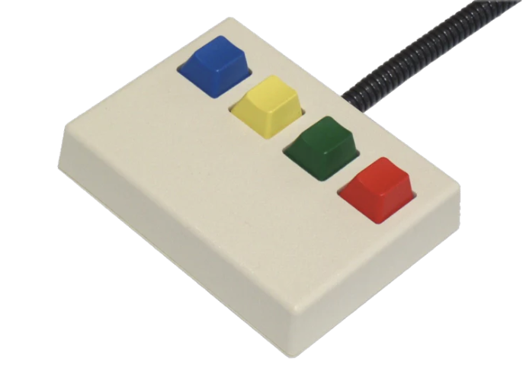
Scanning
We will ask you to respond using two button boxes. You will use your index, middle , and ring fingers on each hand to press the left 3 buttons.
Ethics Number: 2023-27613-44212-3

Slide 4

Scanning
Before entering the scanner, we will place a respiratory belt around your waist to monitor breathing.
The scanner is quite loud, so we will give you in-ear earphones to wear that protect you from the sound and some foam cushioning next to your ears.
Click here for the scanner noise →
Ethics Number: 2023-27613-44212-3

Slide 5
Scanning
The scanner noise means that we won’t be able to hear you during the scans; however, we can see you the entire time you are in the scanner.
If you need to get our attention, you can speak to us between scans or use the emergency buzzer we provide if you are not feeling well and urgently need attention.
We will speak to you through the in-ear earphones between each scan to make sure you are feeling ok, and to instruct you what to do next. You can also ask questions during this time if you forget something.
Ethics Number: 2023-27613-44212-3

Slide 6
Scanning
During the scans, it is very important that you keep your head as still as possible, as even slight movements can blur the images of your brain.
Please do not cross your arms or legs throughout the scanning.
If your arms or legs feel stiff, you can slightly wiggle them between scans, while keeping your head still.
Before each task, you will see a ‘Waiting for Scanner’ screen. Please remain as still as possible from when this appears on the screen.
Ethics Number: 2023-27613-44212-3

Slide 7
Scanning
The scanner can shake during the last scan, this is normal and should not cause concern.
It is also normal to feel some dizziness when you enter and exit the scanner.
This should go away quickly, but you are encouraged to get up slowly when you get off the table at the end of the scans.
Ethics Number: 2023-27613-44212-3

Slide 8
Questions?
Do you have any questions so far?
I will now brief you on one of the tasks you will complete in the scanner…
Ethics Number: 2023-27613-44212-3

Slide 9
Welcome to the Survival Game!
In this game, you will become different powerful animals.
You will also battle other dangerous animals.
Ethics Number: 2023-27613-44212-3

Slide 10
The Animals
Ethics Number: 2023-27613-44212-3

Slide 11



The Animals
In this game, you will play as each of these 3 animals.
Lion
Hyena
Antelope
Ethics Number: 2023-27613-44212-3

Slide 12
The Animals - Lion
Lions are large cats native to Africa.
Lions hunt a variety of prey including hyenas and antelope.
Lions are ~3-4 feet tall and 5-7 feet long. Adult lions weigh 330-550 lbs.
Lions can run up to 50 mph and have sharp claws and teeth.
Ethics Number: 2023-27613-44212-3

Slide 13
The Animals - Hyena
Hyenas are dog-like carnivores native to Africa.
Hyenas hunt a variety of prey including antelope and smaller animals.
Hyenas are ~2-3 feet tall and 3-5.5 feet long. Adult hyenas weigh 90-170 lbs.
Hyenas can run up to 40 mph and have sharp claws and teeth.
Ethics Number: 2023-27613-44212-3

Slide 14
The Animals - Antelope
Antelope are hoofed mammals native to Africa.
Antelope primarily eat shrubs and grasses.
Antelope are ~5-6 feet tall and 6-11 feet long. Adult antelope weigh 75-140 lbs.
Antelope can fight predators with their strong, powerful horns.
Ethics Number: 2023-27613-44212-3

Slide 15
Strength
Ethics Number: 2023-27613-44212-3

Slide 16
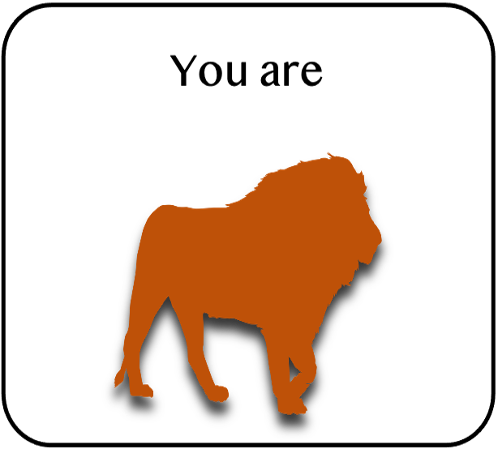
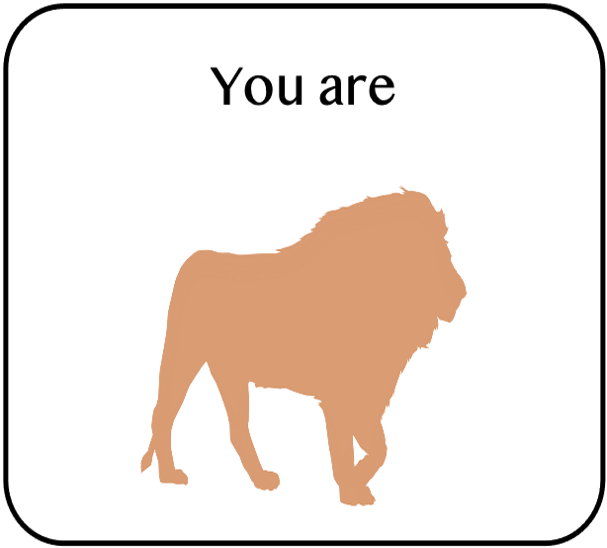
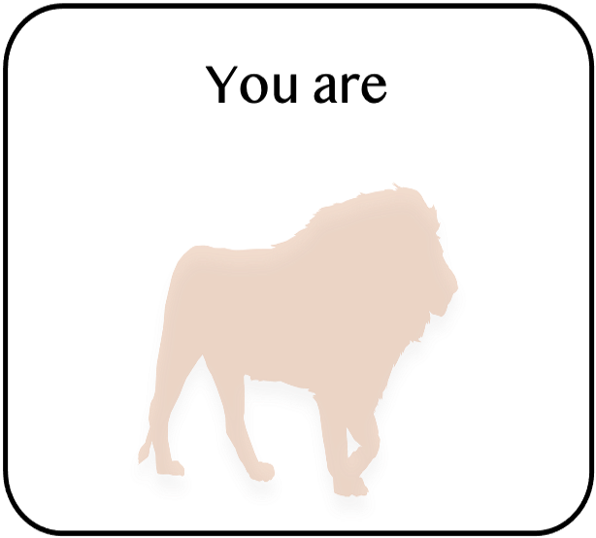
Strength
The animals will vary in strength throughout the game, both when you are playing as the animal and the animals you battle.
Below is an example of the varying strengths of the lion:
Strong
Weak
Ethics Number: 2023-27613-44212-3

Slide 17
Strength
The left darker lion is fully strong.
The right lighter lion is weak, perhaps by malnourishment, age, or injury.
The middle lion is medium strength in between the strongest and weakest lion.
Strong
Weak
Ethics Number: 2023-27613-44212-3

Slide 18
Strength
The stronger Lion is more capable than the weaker lion of defeating other animals.
But the weaker Lion is still a strong predator.
Strong
Weak
Ethics Number: 2023-27613-44212-3

Slide 19
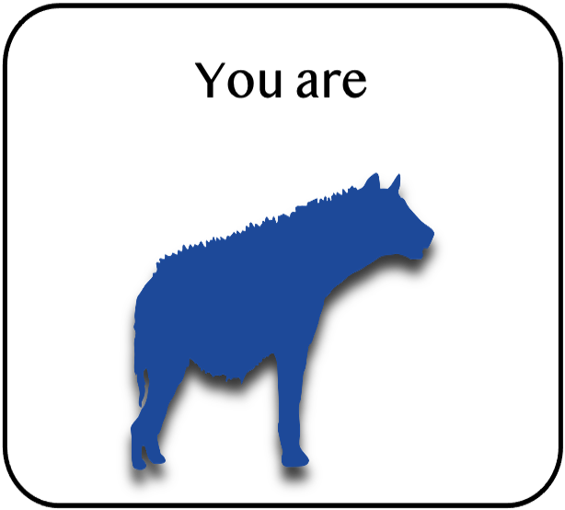
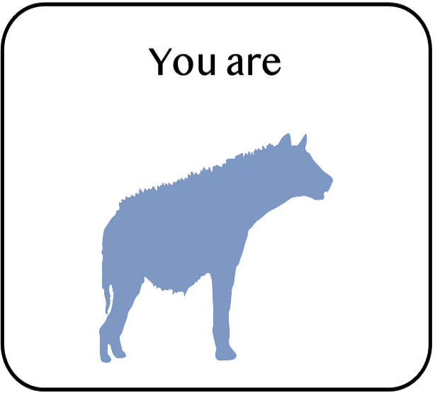
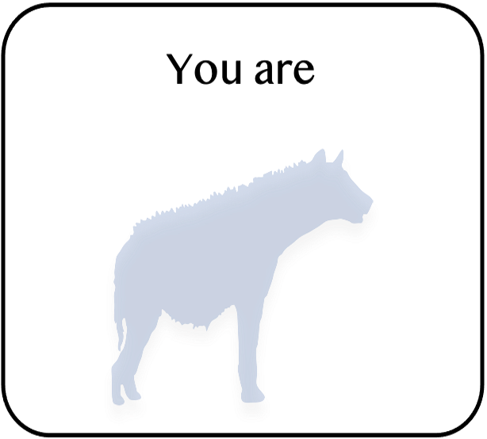
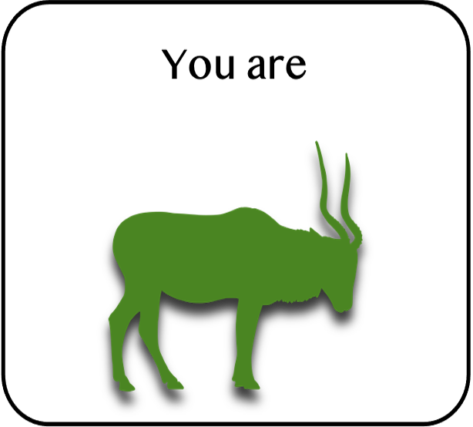
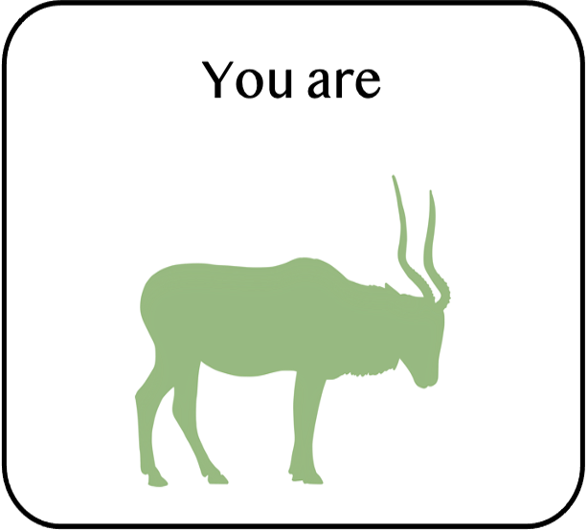
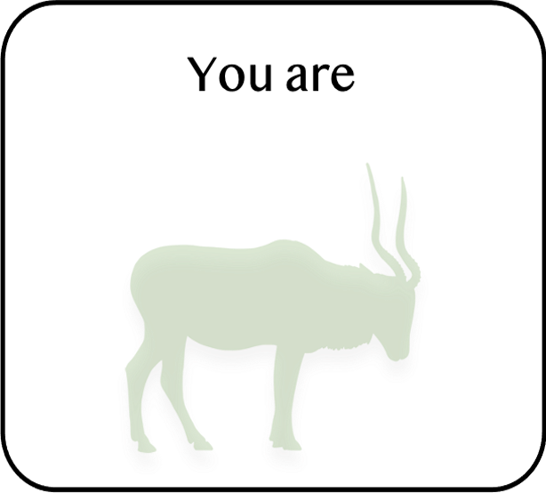
Strength
The hyena and antelope also vary in strength.
Darker colors are stronger, lighter colors are weaker.
Strong
Weak
Strong
Weak
Ethics Number: 2023-27613-44212-3

Slide 20
Game play
Ethics Number: 2023-27613-44212-3

Slide 21
Game Play
During the game, you will play as each animal for several trials before switching to a new animal.
For example, here you will be playing as a hyena of different strength in the next 30 trials:
Ethics Number: 2023-27613-44212-3

Slide 22
Game Play
On each individual trial, you will first know the strength of the animal you are playing.
For example, here you are a medium strength hyena:
Ethics Number: 2023-27613-44212-3

Slide 23
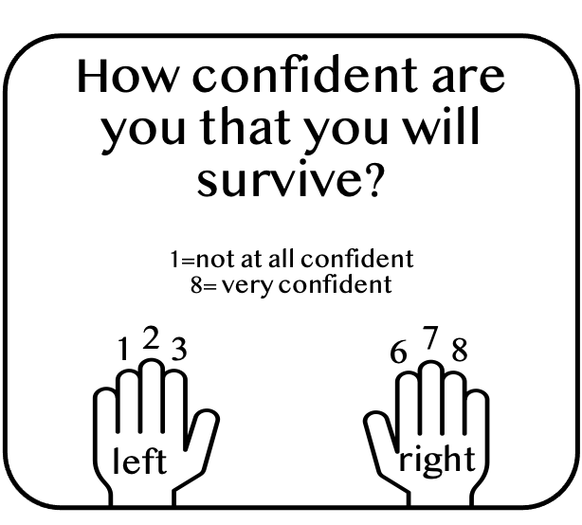
Game Play
You will need to rate your confidence for surviving as a medium strength hyena.
Ethics Number: 2023-27613-44212-3

Slide 24
Game Play
1, 2, 3 are low confidence and 6, 7, 8 are high confidence.
You should make your choices after seeing this screen, and you will only have 5 seconds.
Ethics Number: 2023-27613-44212-3

Slide 25
Game Play
After you know which animal you are and your strength for that individual trial, you will be told who you are battling.
On this battle you are facing the strong antelope:
Ethics Number: 2023-27613-44212-3

Slide 26
Game Play
You will need to rate your confidence for surviving as a medium strength hyena against a strong antelope.
Ethics Number: 2023-27613-44212-3

Slide 27
Game Play
Here is a summary of the screens you’ll see for the given example:
start
end
+
You are shown which animal you are for this individual battle
Here you are a medium strength hyena
You will rate your confidence for surviving as a medium strength hyena
Brief
pause
You are shown which animal you are fighting
Here you are fighting a strong antelope
You will rate your confidence for surviving as a medium strength hyena against a strong antelope
Ethics Number: 2023-27613-44212-3

Slide 28
Outcomes
Ethics Number: 2023-27613-44212-3

Slide 29

Outcomes
If you lose, you will be shown this screen, which means you will hear an unpleasant sound.
Losing does not necessarily mean getting killed, it just means getting defeated.
If you are stronger but the weaker animal escapes, you lose and risk hearing the sound.
Click here for the sound effect️ →
Ethics Number: 2023-27613-44212-3

Slide 30

Outcomes
If you win, you will be shown this screen, which means you won’t hear any sound.
Winning does not necessarily mean killing the animal, it means defeating it in a battle.
If you are weaker but you escape, you will win and be safe from the sound.
Ethics Number: 2023-27613-44212-3

Slide 31
Outcomes
You won’t always win your battle when you’re a stronger predator.
But the likelihood of winning is better the stronger you are and the weaker your competitor is.
You won
You lost
Ethics Number: 2023-27613-44212-3

Slide 32
Some other things…
Ethics Number: 2023-27613-44212-3

Slide 33
Session Information
You will start the session with a 2-minute picture game, where all you need to do is stay still in the scanner.
You will then undergo a 7-minute scan. Meanwhile, you will go through the instructions about another game that you will play while in the scanner.
The instructions might finish earlier than the scanning process, please wait until we speak to you.
You will play 4 rounds of that game. Each round takes about 5 minutes.
After that, you will play another 2-minute picture game.
You will then play 3 rounds of the survival game introduced in this ppt. Each round takes about 10 minutes.
Ethics Number: 2023-27613-44212-3

Slide 34
Session Information
We will check in with you after each round to see how you’re doing.
It is very important that you hold still in the scanner because any small movements can blur the pictures.
Ethics Number: 2023-27613-44212-3

Slide 35
Session Information
START
Setup scans ~1minute
Picture Game 1
~2minutes
Structural Scans
& New Game Instructions
~7minutes
New Game 1
~5minutes
New Game 2
~5minutes
New Game 3
~5minutes
New Game 4
~5minutes
Picture Game 2
~2minutes
DONE!
Survival Game 1
~10minutes
Survival Game 2
~10minutes
Survival Game 3
~10minutes
Ethics Number: 2023-27613-44212-3

Slide 36
Questions?
Ask the experimenter if you have any questions.
After this briefing, you will complete an MRI safety screening with the radiographer.
Ethics Number: 2023-27613-44212-3

